Slide 1

Phase Vocoder Effects
Mutation, Robotisaton, Whisperisation, Pitch shifting, Time scaling

Slide 2
Phase Vocoder
Sound analysis-synthesis techniques performed in spectral domain
widely recognised standard implementation
Decompose signal over short windowed frames (STFT) to analyse frequency content over time
Take into account phase information
Applications
Time scaling & pitch shifting
Signal Content Analysis
Pitch detection
Denoising
Sound synthesis by example
Steady State/Transient Separation
Mutation and cross-synthesis
Robotisation and whisperisation…

Slide 3
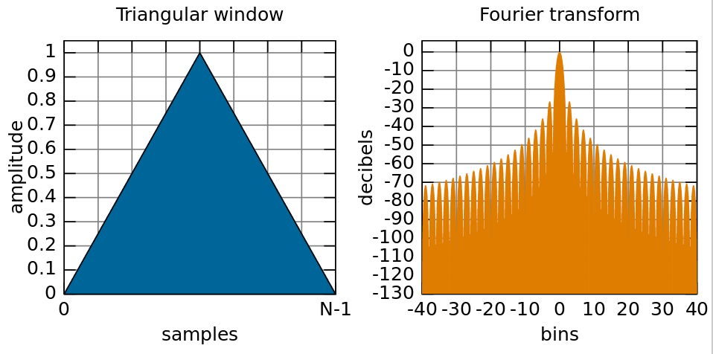
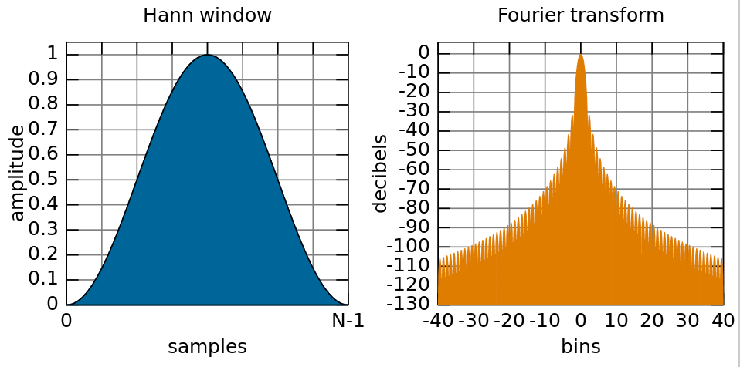
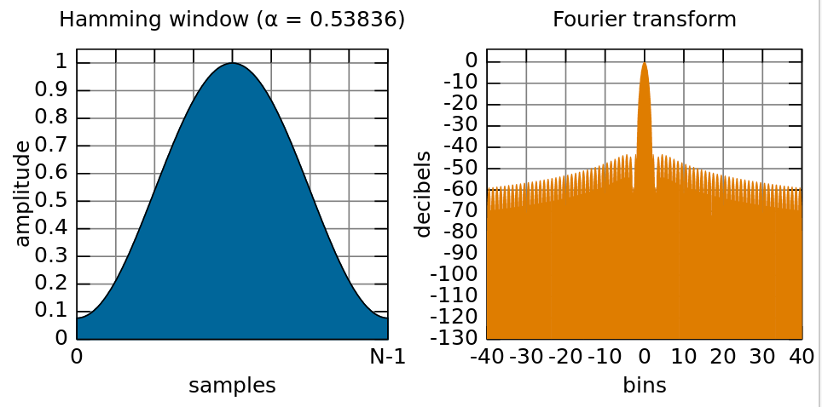
Phase vocoder
What you’ll learn:
Working in frequency domain
Window functions
Segmenting real-time signal into windows
Constant Overlap-Add (COLA) criterion
Analysis and synthesis windows
Reconstructing exact frequency from FFT bin phase
FFT-based frequency detector
What you’ll make:
A phase vocoder framework

Slide 4
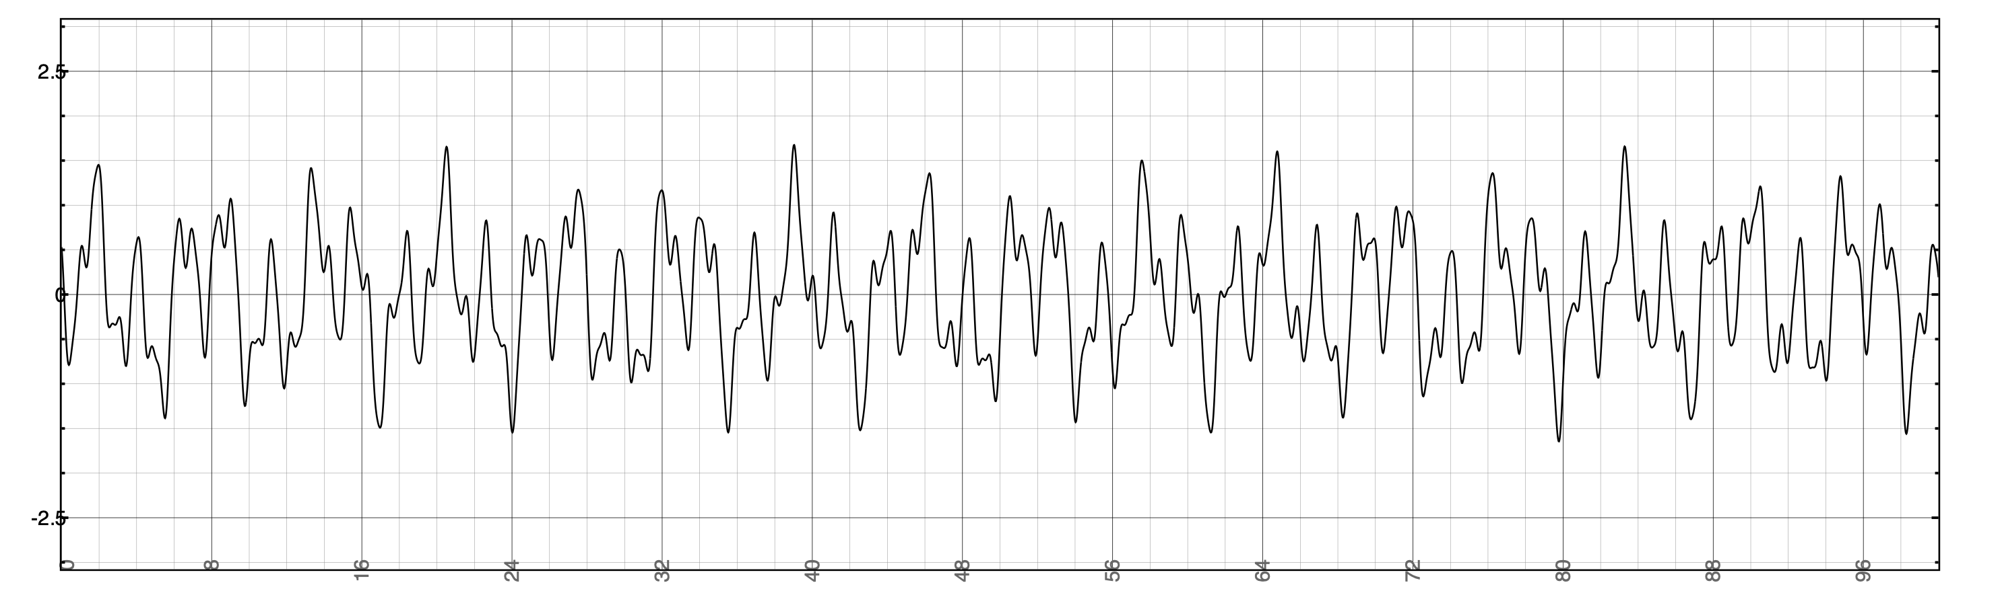
Block-based processing
Sometimes audio calculations need to run on block of samples
E.g., wait until 512 samples arrive, then do something with all of them at once
With block-based processing, usually run calculation periodically
Unlike filters, where new output calculated every sample
After dividing signal into windows, often want to reconstruct it
Process each block
Stitch processed blocks together into new signal
If we don’t process each block, should reconstruct signal exactly
Application: phase vocoder
FFT on each block
Do processing in frequency domain
IFFT on each block

Slide 5
Block-based input
Block 0
Block 1
Block 2
x[n]
S0
S1
S2
S3
S4
S5
S6
S7
S8
S9
S10
S11
S12
S13
S14
S15
S16
S17
S18
S19
S20
S21
S22
S23
...
current
sample
write
pointer
Apply
window
Apply
window
Apply
window
Block-based
processing
Block-based
processing
input
buffer
Block-based
processing
S12
S6
S13
S7
S14
S8
S15
S9
S10
S16
S11
S0
S1
S2
S3
S4
S17
S5
Start with fixed size buffer
Fill it up sample by sample
When full, apply window function and pass it to block-based process (like FFT)

Slide 6
Block-based input and output
Ideal block-based processing system might work something like this:
Block 0
Block 1
Block 2
x[n]
S0
S1
S2
S3
S4
S5
S6
S7
S8
S9
S10
S11
S12
S13
S14
S15
S16
S17
S18
S19
S20
S21
S22
S23
...
current
sample
Problem: not causal!
write
pointer
Apply
window
Block-based
processing
Apply
window
Apply
window
Block-based
processing
input
buffer
Block-based
processing
output
buffer
S12
S13
S14
S15
S16
S17
Y12
Y6
Y13
Y7
Y14
Y8
Y15
Y9
Y10
Y16
Y11
S0
Y17
S6
S1
S7
S2
S8
S3
S9
S10
S4
S11
S5
Y0
Y1
Y2
Y3
Y4
Y5
read
pointer
y[n]
Y0
Y1
Y2
Y3
Y4
Y5
Y6
Y7
Y8
Y9
Y10
Y11
Y12
Y13
Y14
Y15
Y16
Y17
...

Slide 7
Block-based output: causality
For causal system, output cannot depend on future inputs
Partial solution: add 1-window latency to output
As we gather input samples for next FFT, copy samples from last FFT into output
Block 0
Block 1
Block 2
x[n]
S0
S1
S2
S3
S4
S5
S6
S7
S8
S9
S10
S11
S12
S13
S14
S15
S16
S17
S18
S19
S20
S21
S22
S23
...
...
Block-based
processing
Block-based
processing
Block-based
processing
Block-based
processing
y[n]
S0
S1
S2
S3
S4
S5
S6
S7
S8
S9
S10
S11
S12
S13
S14
S15
S16
S17
S18
S19
S20
S21
S22
S23
...
Problem: y[0] depends on x[5]. System is not causal!

Slide 8
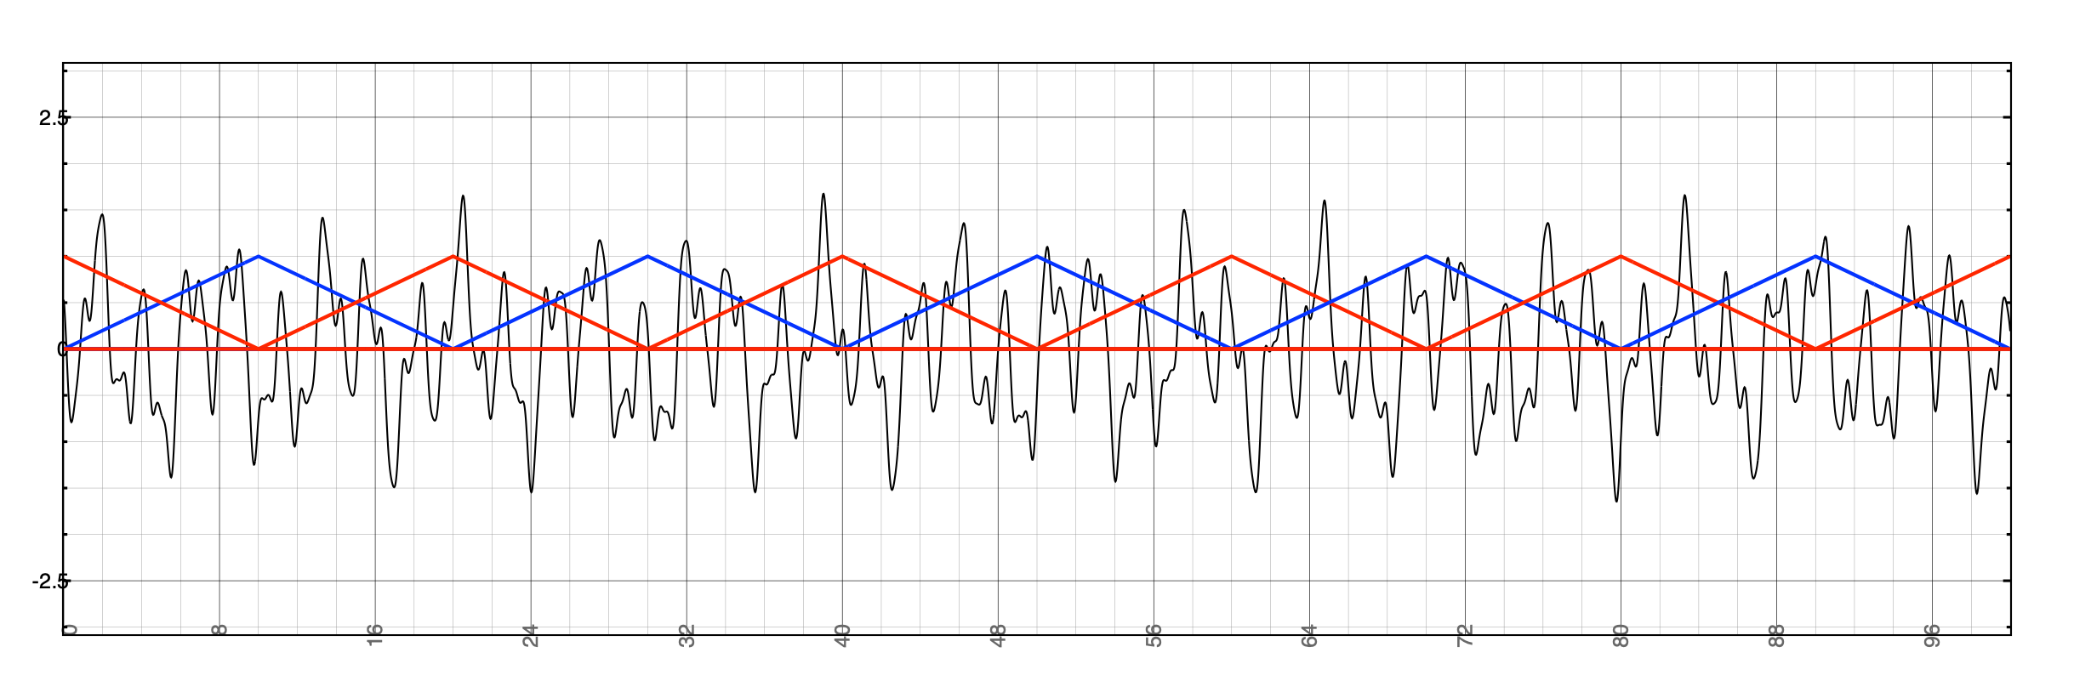
Overlapping blocks
Split signal into overlapping segments
# samples between consecutive blocks is hop size
Often fraction of block size (or window size)
Might apply window before calculating FFT
triangular windows, hop size M/2
DFT of each segment to get frequency content
IDFT to get back
Window size = M
Hop size = M/2

Slide 9
Overview of Overlap and Add Process
x[n]
...
Break input signal into windows
Take m^{th} segment of length M using windowing function
Take FFT of length N ≥ M of segment
If N > M, zero-pad the segment (add zeros to end)
Extract amplitudes and phases
Do something to frequency data
Take IFFT to get new time domain segment
Add result to output buffer containing prior segments
Advance by hop size to (m+1)^{th} frame and repeat
...
Hop Size
FFT
Window Size
for each window:
Frequency Domain
Processing
IFFT
...
Add results of each IFFT to output
+
+
+
+
+
+
...
y[n]

Slide 10
Review: overlapping blocks (input side)
Block 0
Block 1
Block 2
x[n]
S0
S1
S2
S3
S4
S5
S6
S7
S8
S9
S10
S11
S12
S13
S14
S15
S16
S17
S18
S19
S20
S21
S22
S23
...
S0
S1
S4
S5
S6
S7
S8
S9
S12
S13
S14
S15
S16
S17
S20
S21
S22
S2
S23
S3
S10
S11
S18
S19
y[n]
...
Goal is to work with overlapping blocks in real time
This means block k shares some samples with block k-1
How do we adapt our windowing code to handle this?
Easiest approach: keep running history of input samples
i.e. buffer which always has last M samples
What kind of structure does this?
At each hop, pass M samples from circular buffer to FFT
Circular buffer

Slide 11
Review: overlap-add with a circular buffer
Use circular buffer to keep track of input
Necessary characteristics:
Buffer always holds (at least) last M input samples (where M is the window size)
If using multiple channels, one buffer per channel
Using circular buffer:
Each iteration of for() loop:
store input in buffer
increment write pointer (wrapping as necessary)
increment total count of samples stored
When count reaches hop size:
take one window from buffer, unwrap it, and pass it to FFT
i.e, copy it to new buffer such that oldest sample appears at index 0 of new buffer
latest
window
(M = 8 in this
example)
x[23]
x[24]
x[25]
x[22]
x[26]
x[21]
x[3]
x[20]
x[4]
x[19]
x[5]
Not same as when write
pointer wraps around!
write pointer
x[18]
(next sample to
be replaced)
x[6]
x[17]
x[7]
x[16]
x[8]
x[15]
x[9]
x[14]
x[10]
x[13]
x[12]
x[11]

Slide 12
Review: unwrapping the circular buffer
How circular buffer stored in memory:
latest
window
(M = 8 in this
example)
x[24]
x[25]
x[26]
x[3]
x[4]
x[5]
x[6]
x[7]
x[8]
x[9]
x[10]
x[11]
x[12]
x[13]
x[14]
x[15]
x[16]
x[17]
x[18]
x[19]
x[20]
x[21]
x[22]
x[23]
x[23]
x[24]
x[25]
x[22]
x[26]
x[21]
x[3]
What we need to calculate FFT (latest 8 samples):
x[4]
x[20]
x[19]
x[5]
x[19]
x[20]
x[21]
x[22]
x[23]
x[24]
x[25]
x[26]
write pointer
x[18]
(next sample to
be replaced)
x[6]
x[17]
x[7]
In other words: having assembled samples into circular buffer, on each hop it is helpful to copy them into linear (standard) buffer to pass to FFT library
x[16]
x[8]
x[15]
x[9]
x[14]
x[10]
x[13]
x[12]
x[11]

Slide 13
Block-based output: overlap
Block 0
Block 1
Block 2
x[n]
S0
S1
S2
S3
S4
S5
S6
S7
S8
S9
S10
S11
S12
S13
S14
S15
S16
S17
S18
S19
S20
S21
S22
S23
...
These output
samples are sum of parts of two different blocks
Block-based
processing
Block-based
processing
Block-based
processing
Block-based
processing
Block-based
processing
output
buffer
Need intermediate output buffer (different from system audio output) to hold results of block-based calculation
Each window, new output should be added into that buffer
Sample can be sent from there to system output as soon as all blocks it depends on have been calculated (implies latency of at least 1 window)

Slide 14
Output circular buffer
Output
circular buffer:
Circular buffer to get output from overlap-add
Different from input circular buffer
Keep track of 2 pointers in circular output buffer
Write pointer: where does next block get written?
moves in jumps of hop size
Read pointer: where to get next sample for output?
moves continuously frame by frame
Write pointer must remain ahead of read pointer
Necessary characteristics of the output buffer:
Hold at least W+H samples, for W window size, H hop size
One buffer per channel of signal
Need array, write pointer from FFT & read pointer to system output
Using output buffer:
After inverse FFT, add result to output buffer, starting at write pointer
In processBlock, copy from output buffer to audio output at read pointer
Then set sample you just copied to 0
Finally, increment read pointer
xxx
xxx
xxx
xxx
xxx
xxx
xxx
xxx
xxx
xxx
xxx
read
pointer
xxx
xxx
xxx
xxx
write
pointer
xxx
xxx
xxx
xxx
xxx
xxx
xxx
xxx
xxx

Slide 15
The full signal chain
Block 0
Block 1
Block 2
x[n]
S0
S1
S2
S3
S4
S5
S6
S7
S8
S9
S10
S11
S12
S13
S14
S15
S16
S17
S18
S19
S20
S21
S22
S23
...
write
pointer
happens once per hop (every H samples)
most
recent W
samples
add
result
input
buffer
Apply
window
Block-based
processing
output
buffer
at write
pointer
these processes
happen every frame
read pointer
S0
S1
S4
S5
S6
S7
S8
S9
S12
S13
S14
S15
S16
S17
S20
S21
S22
S2
S23
S3
S10
S11
S18
S19
y[n]
...

Slide 16
The full signal chain: added latency
Block 0
Block 1
Block 2
x[n]
S0
S1
S2
S3
S4
S5
S6
S7
S8
S9
S10
S11
S12
S13
S14
S15
S16
S17
S18
S19
S20
S21
S22
S23
...
write
pointer
We have 1 full hop to
finish FFT calculations
most
recent W
samples
add
result
input
buffer
Apply
window
Block-based
processing
output
buffer
at write
pointer
read pointer
S0
S1
S4
S5
S6
S7
S8
S9
S12
S13
S14
S15
S16
S17
S20
S21
S22
S2
S23
S3
S10
S11
S18
S19
y[n]
...

Slide 17
Synthesis
Block 0
Block 1
Block 2
x[n]
S0
S1
S2
S3
S4
S5
S6
S7
S8
S9
S10
S11
S12
S13
S14
S15
S16
S17
S18
S19
S20
S21
S22
S23
...
write
pointer
possible problem:
discontinuity at block edges
most
recent W
samples
add
result
input
buffer
Apply
window
Block-based
processing
output
buffer
at write
pointer
read pointer
S0
S1
S4
S5
S6
S7
S8
S9
S12
S13
S14
S15
S16
S17
S20
S21
S22
S2
S23
S3
S10
S11
S18
S19
y[n]
...

Slide 18
Analysis and synthesis windows
Block 0
Block 1
Block 2
x[n]
S0
S1
S2
S3
S4
S5
S6
S7
S8
S9
S10
S11
S12
S13
S14
S15
S16
S17
S18
S19
S20
S21
S22
S23
...
write
pointer
Apply window function again after frequency-domain processing
Same length as analysis window, but could be different type
most
recent W
samples
add
result
input
buffer
Apply
window
Block-based
processing
Apply
window
output
buffer
at write
pointer
analysis
window
synthesis
window
read pointer
S0
S1
S4
S5
S6
S7
S8
S9
S12
S13
S14
S15
S16
S17
S20
S21
S22
S2
S23
S3
S10
S11
S18
S19
y[n]
...

